Slide 1

Speak fluently
Intermediate

Slide 2
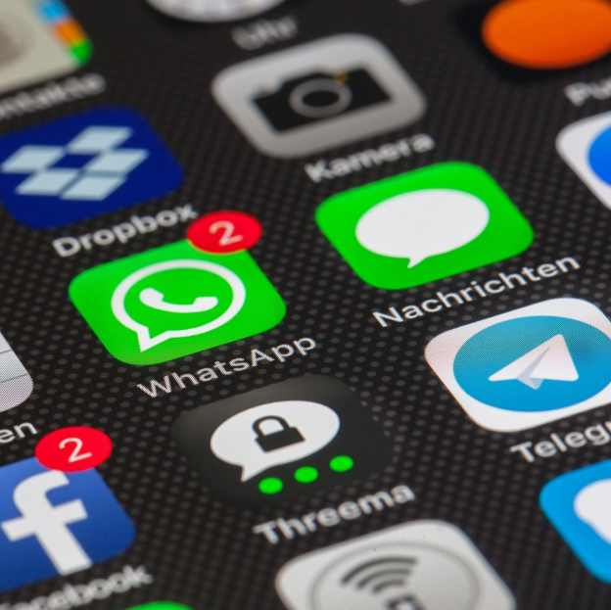
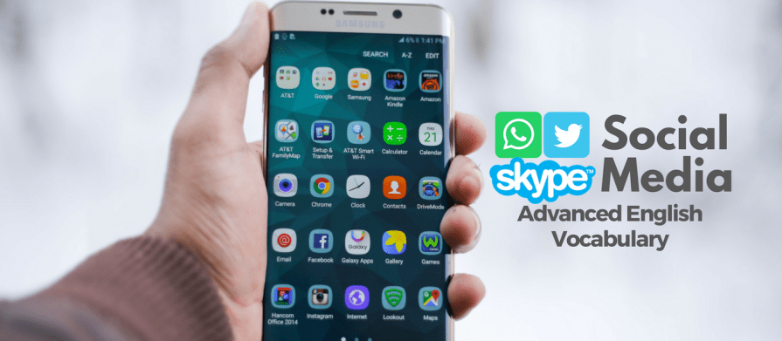
9. Social Media

Slide 3
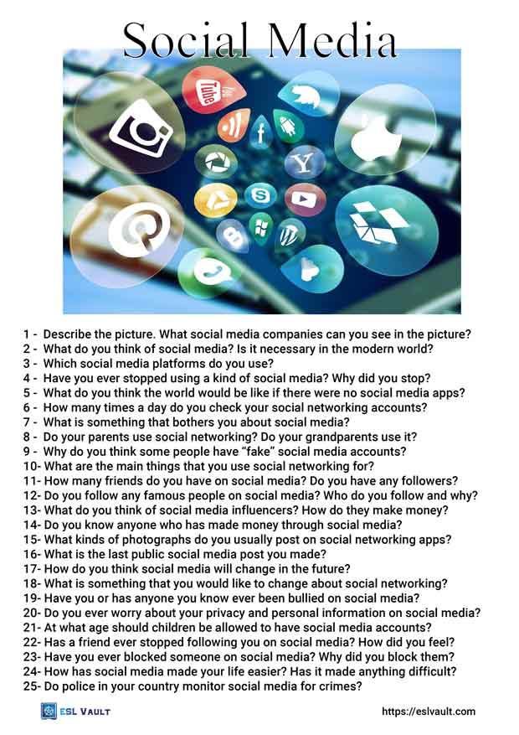
9. Social Media
Do you agree that social networking sites are for people who are
not good at meeting people face to face?
2. Have you ever tried to find new friends on a social network?
3.What various activities can you do on a social networking site?
4.Do you think teenagers' activities on social networking sites
should be supervised by parents? How? Why?
5.How is your life different without social networks?
6.Would you prefer to meet new people at a party or online? Why?

Slide 4
9. Social Media
What springs to mind when you hear the term ‘social media’?
What’s the difference between social media and social networking?
While the two words seem to be interchangeable, they have distinct differences.
Essentially, social media requires a social network in order to give out content to those that wish to consume and interact with it. Thus, the social media network is the underlying technology and human connections, while social media focuses strictly on what is being published and consumed within the social networking platform.
3) Have you joined any social networking sites? Are they fun?
4) Are social networking sites for people who aren’t good at meeting people face to face? 5) What’s the best social networking site?
5) Should companies ban their employees from using social networking sites at work? 7) What new features would you like to see on social networking sites?
6) Have you ever tried to find friends on a social networking site?
7) Do you think your country’s leader has a page on a social networking site? What do you think it might contain?
8) What are the pros and cons of social networking?

Slide 5
9. Social Media
9. What social networking sites do you use?
10. What are some good points about social networking?
11. What are some bad points about social networking?
12. Do you have a Facebook page?
13. Do you use Twitter?
14. What information do you have on your webpage?
15. What kind of information are you comfortable releasing to the public?
16. Do your parents use social networking sites?
17. What type of information should you put on social networking sites?
18. what are the positives of social media?
19. We often hear about the negative side of social media. But what are the benefits?
20. Should children be allowed to use social networking sites?

Slide 6
9. Social Media
21. Do you prefer to access social networks on a laptop, tablet, or mobile phone? Is there any difference in experience?
22. Is it possible that social networking sites make people lonelier?
23. Which sites of famous people would you like to join?
24. Would you prefer to meet new people at a party or online?
25. Are social networking sites changing our daily behavior?
26. Which social network has the most functions? Which social network has the most useful functions? Have you ever sold anything on a social network? Have you ever bought ads? How satisfied were you with the results?
27. Which social network is the most fun? Why? Which social networks are boring? Why?
28. If you could keep only three social networks and the rest disappeared, which ones would you choose and why? If you could keep only one, which would you choose and why?
29. Can you remember a time before you used social networks? How did you… a) make new friends online? b) Have fun online? c) Discover the news online? d) Share photos and videos online?
30. How did people keep in touch with friends in the past, before social networks came along? Would you like to go back to those days? Why? Why not?

Slide 7
9. Social Media
31. Are social networks essential, or an unnecessary distraction? Can you imagine a world without social networks? Give reasons for your answers.
32. Are you comfortable sharing information about yourself on multiple social networks? What dangers do social networks pose? Are you happy to trade your privacy in order to get free access to a social network? Why? / Why not? Would you pay monthly to get more privacy on a social network? Why? / Why not?
33. Have you ever had a problem using a social network? Tell me about it.
34. What do you do when you see something you don’t like, or don’t agree with, on a social network?
35. Do you think that children should be allowed to register for social networks? Why? / Why not?
36. Is the number of friends or followers that you have on social networks important to you? Why? / Why not? How many friends have you got on Facebook? How many of them are real friends? What about on other social networks?
37. Do you rely on social networks to get… a) local news, b) national news, c) international news? How reliable do you think the news sources are?

Slide 8
9. Social Media
Social media terms you need to know:
Viral: Anything shared across social networks that get passed along rapidly. YouTube videos are a great example.
2. Platform: A system that manages content. For instance, Wordpress is a platform that manages a community of blogs.
3. Authenticity: Used to describe "real" people behind blog posts and other social profiles.
4. Hashtag: a "word or string of characters that starts with a number sign." Identical hashtags are then grouped into a search thread.
5. Search Engine Optimization (SEO): The process of organizing your website to give it the best chance of appearing near the top of search engine rankings.
6. Transparency: Social media users expect to engage in considerate online conversations with individuals and businesses. We all aspire to be transparent, but are we?
7. Phishing: a terrible thing which means trying to catch people in some scam and get their personal information from them to steal them.

Slide 9
9. Social Media
Social media terms you need to know:
8. Trending: A word, phrase or topic that is popular on Twitter at a given moment.
9. e-Book: A book published in digital form.
10. Handle: the name that someone is known by on social media. That is their ‘handle’.
11. Blog: A site updated frequently by an individual or group to record opinions or information.
12. Tweeps: Twitter + People = Tweople.
13. Microblogging: Short message postings from a social media account. Facebook statuses and Twitter posts are two examples.
14. Algorithm: An "algo" is a system that suggests pages to search engines in response to a search query.
15. Widget: A widget is a small, attractive applications on a website such as a hit counter. Gizmos can make good link bait. Speaking of link bait...
16. Link bait: Designed to attract incoming links. News and widget hooks are good examples.

Slide 10
9. Social Media
Social media terms you need to know:
17. Meme: A means of taking viral concepts and making them everyday lingo. Check out "Know Your Meme.“
Know your Meme: a website dedicated to documenting Internet phenomena: viral videos, image macros, catchphrases, web celebs and more.
18. Engagement: If you are communicating (like sharing something for example)to other social media users, you are engaging.
19. Traffic: Traffic, traffic, traffic. This refers to the visitors that visit a website and it's all we talk about these days. A bit of advice: You must decide if traffic to your site is really that important to your organization, or if engaging with a loyal customer matters more.
20. Tag: Indicates or labels what content is about.
What social media terms do you find difficult to understand? Do you have other words or acronyms that you think we should add to our list? We want to know.
21. Clickbait
Hook you into clicking: Trick you or entice you into clicking
e.g. My mother falls for clickbait all the time, she believes everything she reads on the internet!”
22. Cyberbully: another bad word which means using the internet to send hateful or harmful messages to others.
23. DM= Direct message
24. PM= Private message

Slide 11
9. Social Media
Phrases :
Fear of missing out: A concern that your friends/family are going to do something fun but you will not be able to participate.
You only live once: A phrase which is used to encourage somebody to take an opportunity, giving the idea that life is short.
Social networking : the use of internet-based social media platforms to stay connected with friends, family, or peers.

